Slide 1
Blind Spot Detector Featuring the Raspberry Pi
Developed by:
Josh Vetter & Marco Payan

Slide 2
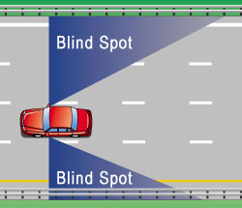
Problem:
Objective:
To provide significant safety upgrade to vehicles with blind spot issues
Solution:
Motion Detector + Two Way Mirror + Monitor + Raspberry Pi
Every year there are approximately 840,000 side to side blind spot collisions with around 300 deaths occurring from these accidents in the United States of America (accidentMI.com).

Slide 3
Schedule
Create Proposal – September 30th
Gather/Order Supplies - November 1st
Progress Report - November 4th
Create software – November 15th
Build hardware components – November 20th
Test hardware efficiency – November 21st
Debug/Test software with hardware – November 25th
Finalize/Clean up – November 28th

Slide 4
Risks
Never created software for a Raspberry Pi (inexperience with python)
Supplies arriving on time
Hardware being defective or having internal errors.
Hardware might not fit inside each other properly (mirror inside car case)
Motion detectors sensitivity may not be adequate.

Slide 5
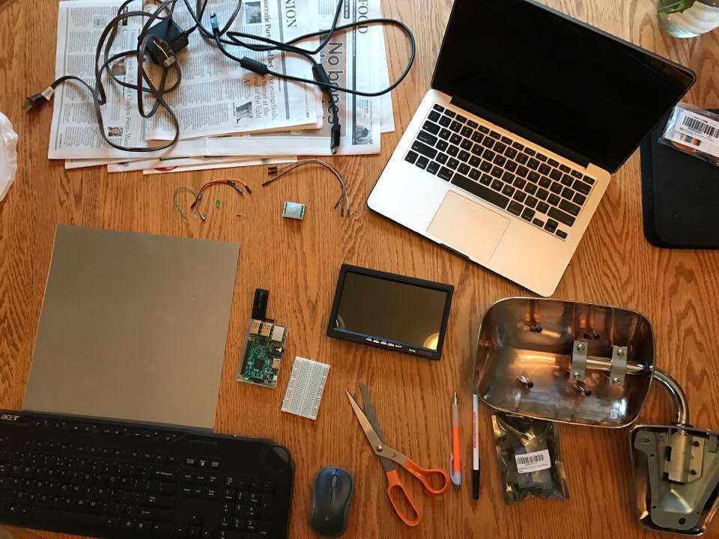
Supply List
Raspberry Pi
2.8 inch monitor
Car side mirror
Motion Sensor (infrared)
Laptop/Keyboard/Mouse
Breadboard
Acrylic See-Through Mirror
HDMI cord
Green LED
Raspberry Pi wires
Miscellaneous (pens, scissors)

Slide 6
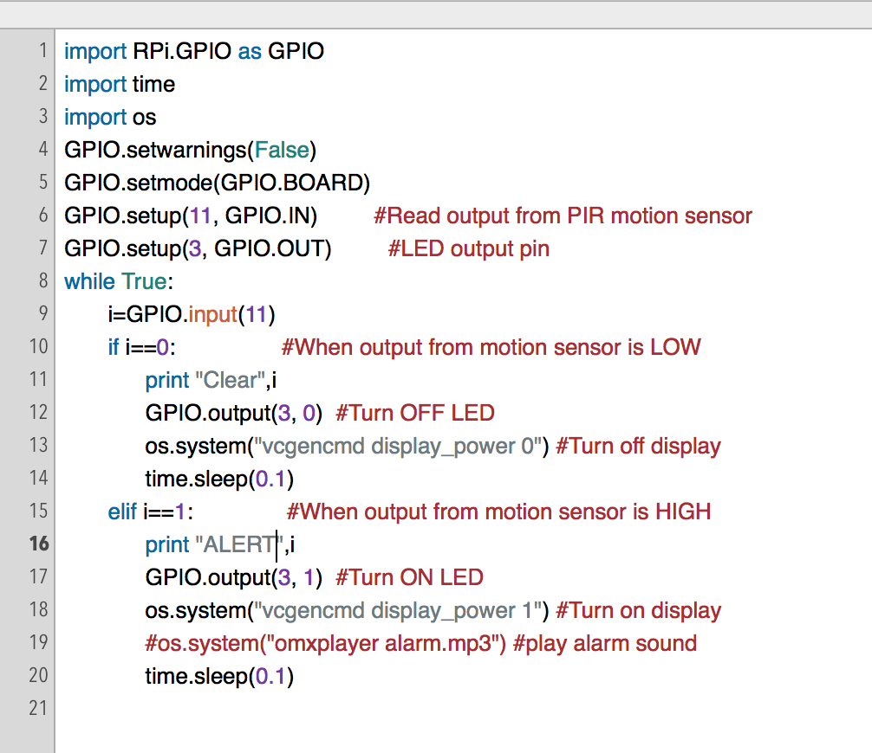
Software
Uses Python

Slide 7
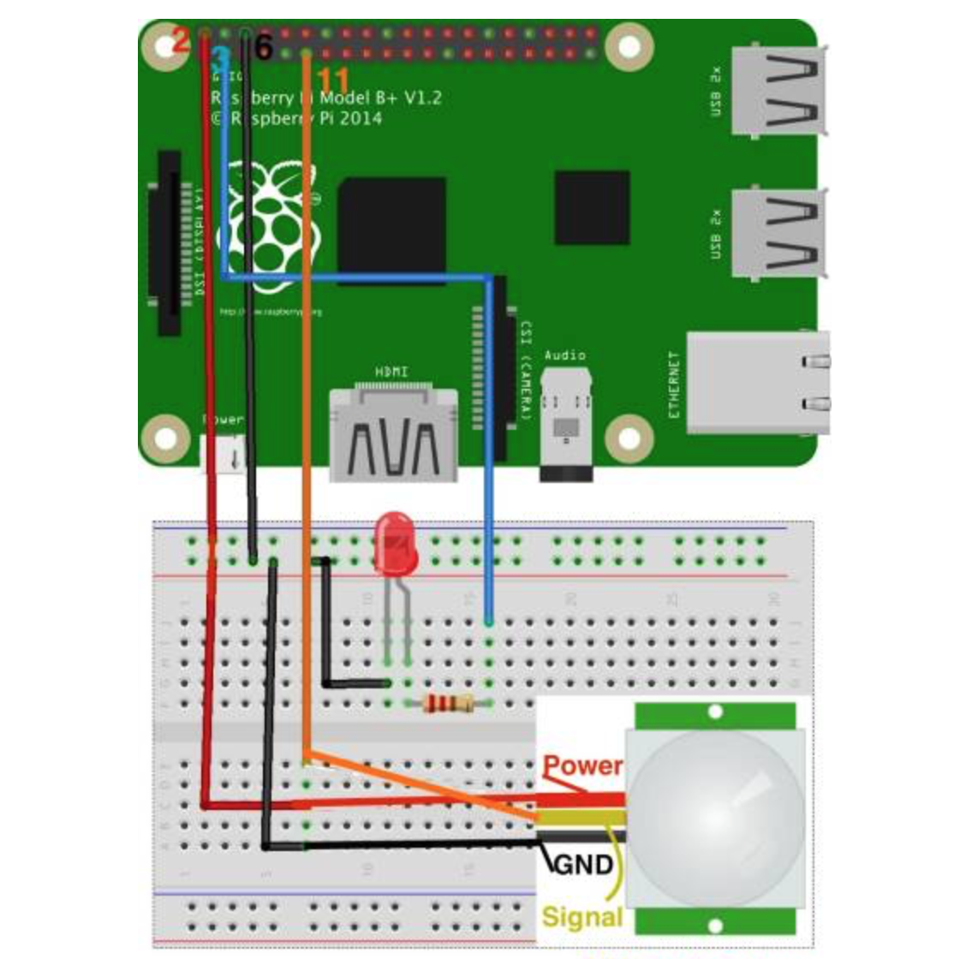
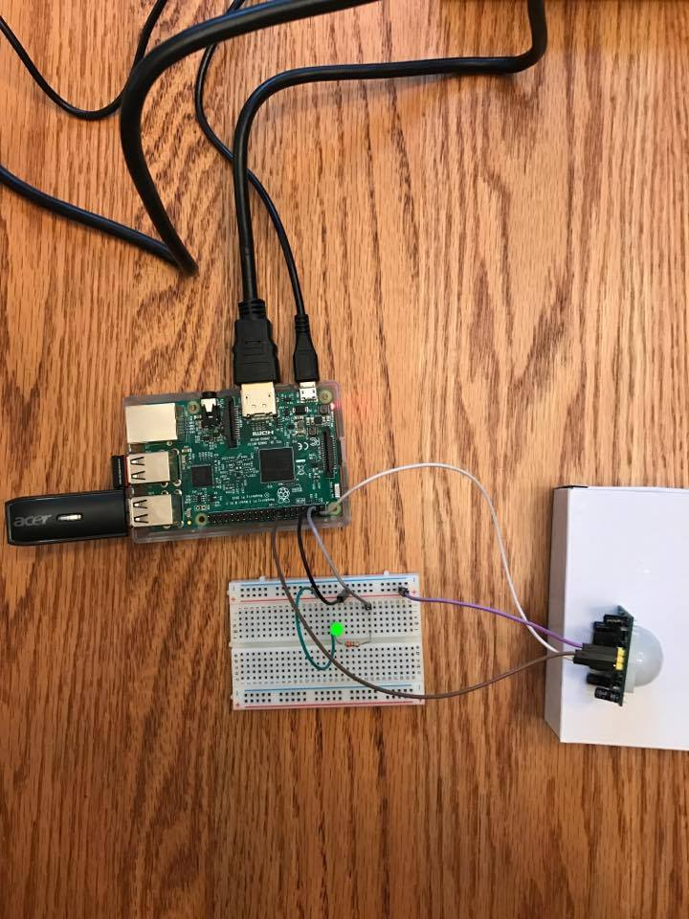
Software Hardware

Slide 8
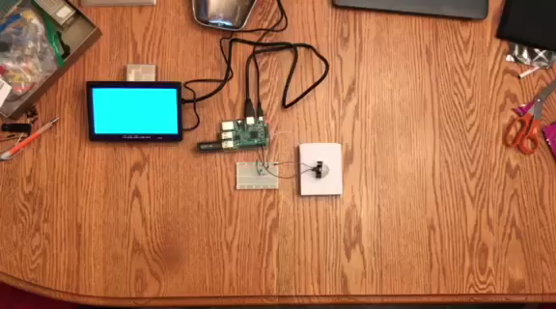
Software Test

Slide 9
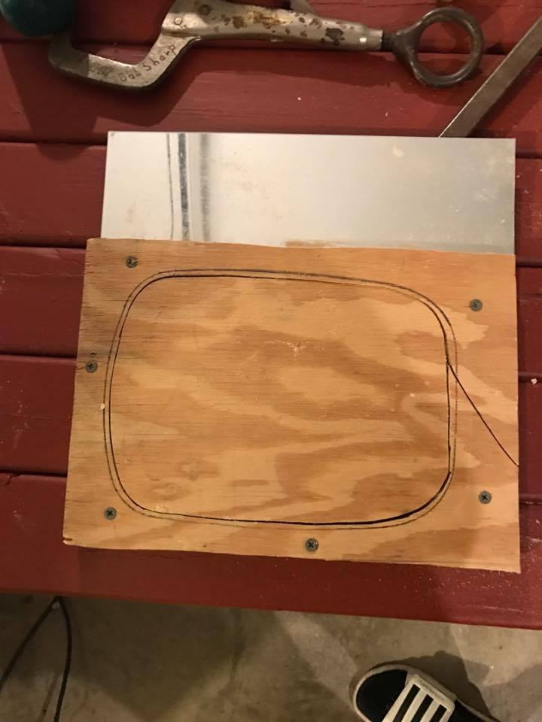
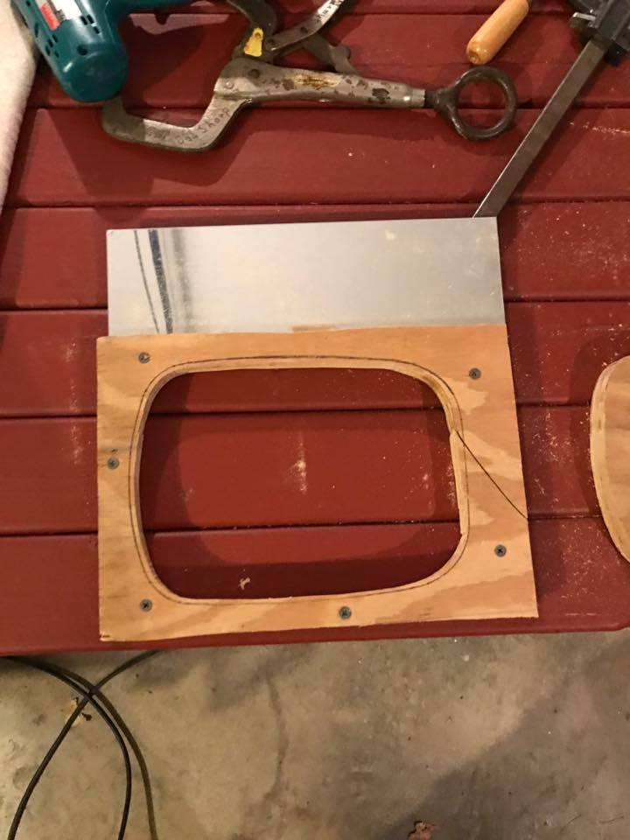
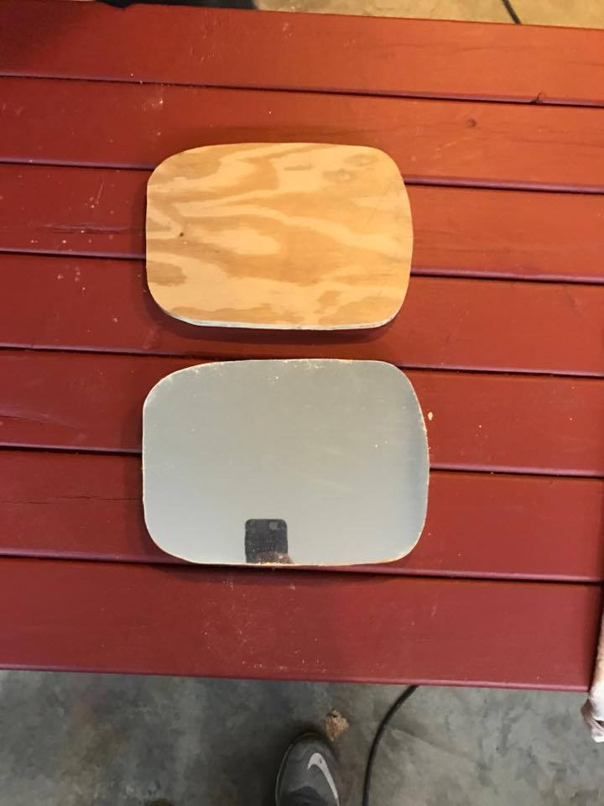
Cutting the Mirror

Slide 10
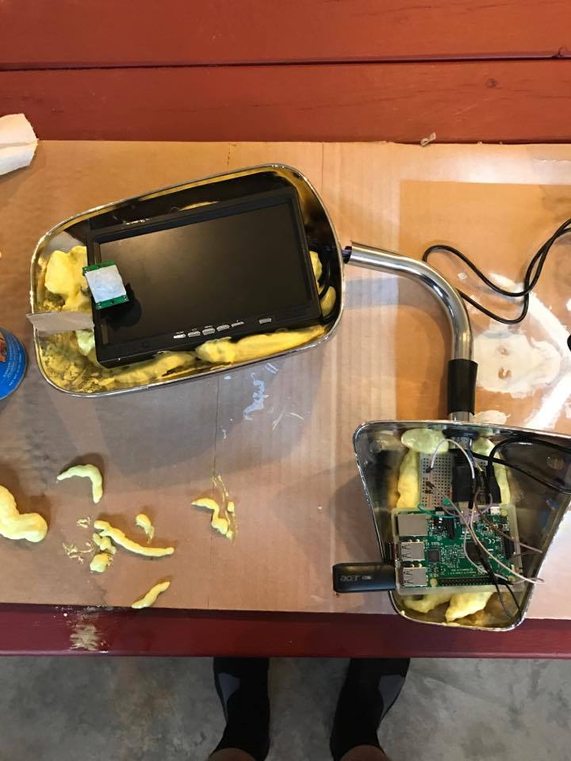
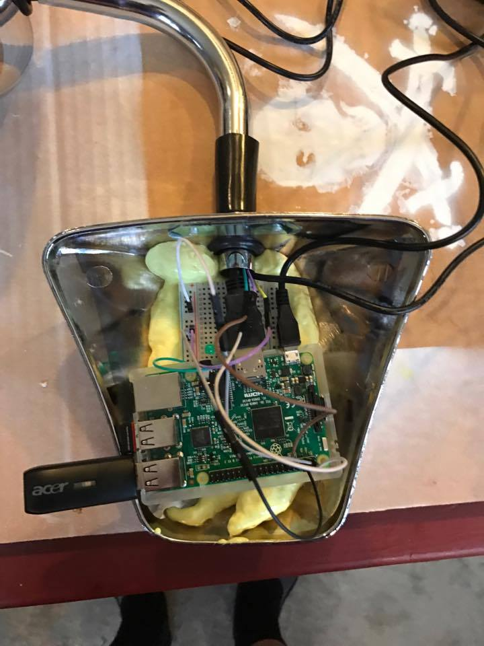
Putting it all together
Used a window/door foam spray to glue all the pieces together

Slide 11
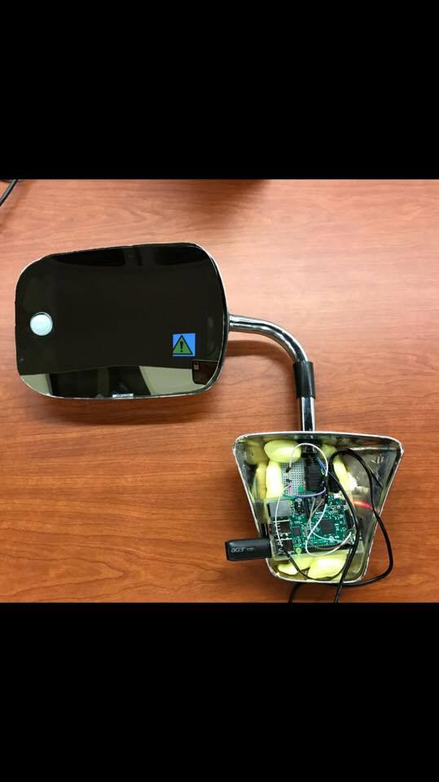
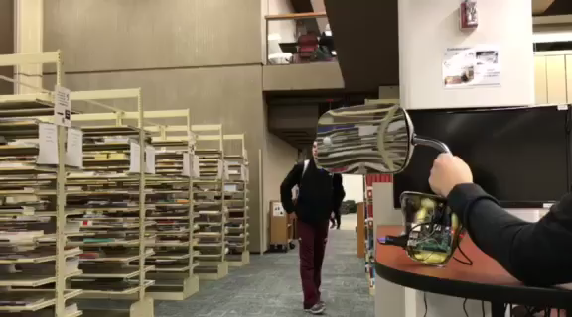
Final Product/Demo

Slide 12
Questions?

